Slide 1
THE PATH TOWARDS A TECHNOLOGICAL INTERVENTION: Evaluating Verification and Validation Methods*
Introduction to Artificial Intelligence
27 September 2022
Dr. Sara Lusini
s.lusini@vu.nl
*These slides are based on a previous presentation by Dr. M. Klein.

Slide 2
CONTENT
PART 1
Learning Objectives
The path towards a Technological Intervention
Verification vs Validation
Exercise 1 (about 10 minutes preparation + 10 minutes discussion)
BREAK (10 minutes)
PART 2
External Validation
Experimental vs Control group
Evaluating intervention effects and statistical relevance
PART 3
Setting up a (schematic) Research Protocol
External Validation of Research Protocol:
Validation (measure impact of intervention)
User evaluation
Exercise 2 (about 10 minutes preparation + 10 minutes discussion)

Slide 3
PART 1 Learning objectives of this lecture
Upon completion of this lecture, students will be able to:
Use the scientific terminology relative to Verification & Validation Methods and their evaluation.
Design a basic Research Protocol for the (external) validation of a Technological Intervention.
How will we get there?
Here is the process step-by-step:
The bigger picture: provide an overview of the Technological Intervention process.
Discuss and understand the difference between Validation and Verification, and why they are both needed.
Discuss examples of Research Protocols for the (external) validation of a Technological Intervention.
a
b
c

Slide 4
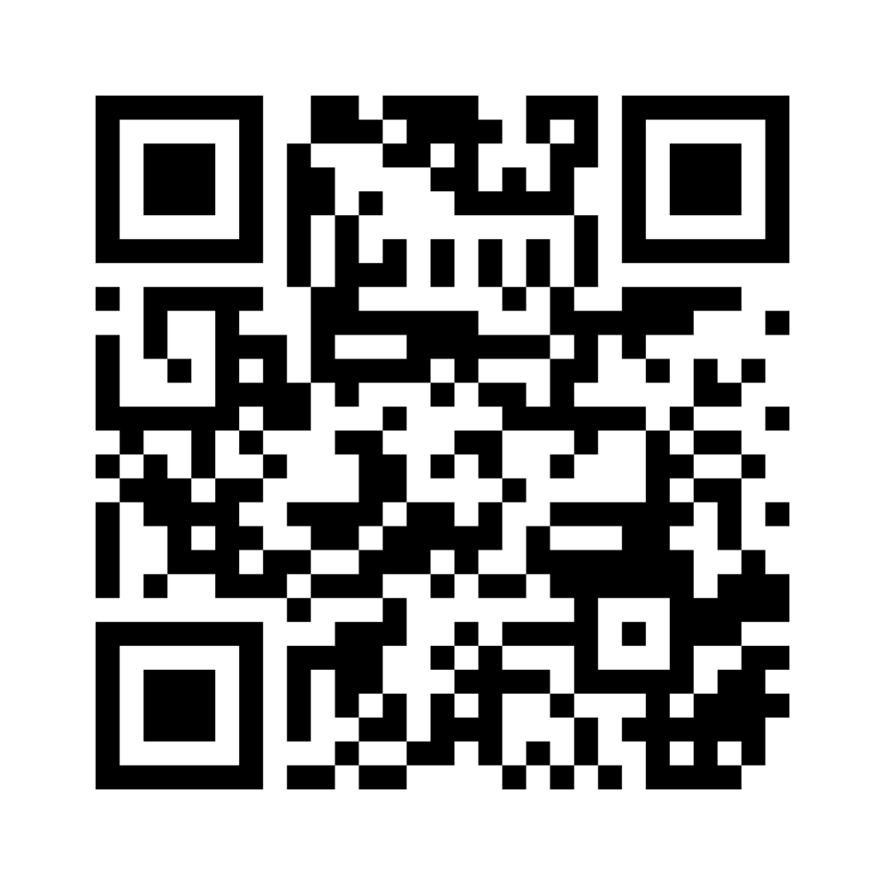
Technological intervention…what’s that?
Write down of a lifestyle or medical app supporting health that you used and did not work well for you (e.g. related to exercise, nutrition, sleep, meditation, blood sugar measurement etc.). Think of why it didn’t work.

Slide 5
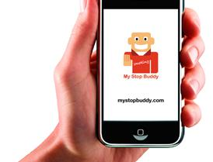
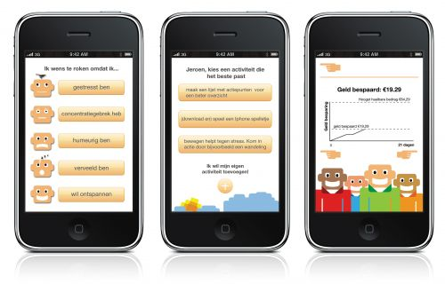
example: AN APP THAT HELPS PEOPLE TO STOP SMOKING and provides users with a personalized plan and advice

Slide 6
INTERVENTION SYSTEM
Designing the System
Define system requirements and target groups.
Implementing the System
Design System Architecture and Inference Engine, Code.
Using the System
Validation + user evaluations
Testing the System
Evaluate Verification and fine-tune parameters
Notes:
In the field of Artificial Intelligence, inference engine is a component of the system that applies logical rules to the knowledge base to deduce new information. The first inference engines were components of expert systems. The typical expert system consisted of a knowledge base and an inference engine. The knowledge base stored facts about the world. The inference engine applies logical rules to the knowledge base and deduced new knowledge. This process would iterate as each new fact in the knowledge base could trigger additional rules in the inference engine. Inference engines work primarily in one of two modes either special rule or facts: forward chaining and backward chaining. Forward chaining starts with the known facts and asserts new facts. Backward chaining starts with goals, and works backward to determine what facts must be asserted so that the goals can be achieved.
The logic that an inference engine uses is typically represented as IF-THEN rules. The general format of such rules is IF <logical expression> THEN <logical expression>.

Slide 7

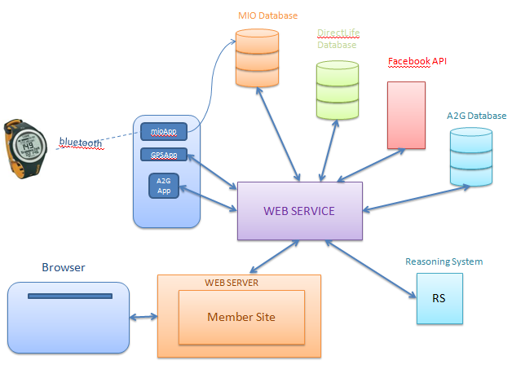
THE PATH TOWARDS A TECHNOLOGICAL INTERVENTION
System design
System Requirements
Target groups/test subjects
System implementation
System Architecture
Inference Engine
Programming
System Testing (verification)
Do the components work?
Does the system give the expected output based on a given input?
System Validation
Does the system help its users achieve their goal?
How is the overall user experience?

Slide 8
VERIFICATION & VALIDATION
Verification is the process of checking whether the software system meets the specified requirements of the users ☞ Testing the system’s Correctness: Is the system doing what it is supposed to be doing? Can it correctly keep track of how much the users are smoking? Is it able to provide users with personalized plans targeting individual users’ need?
Validation is the process of checking whether the software system meets the actual requirements of the users ☞ Testing the system’s Effectiveness Does the system actually work? Does it help its users smoke less or quit smoking?

Slide 9
Internal vs external validation
Building the System
Using the System
Internal validation
External validation
Verification Components/models Simulations
Parameter tuning
Validation
Measure the impact/effect of the intervention/
(user) evaluations

Slide 10
Exercise 1: set up INTERVENTION
First, think of a new Lifestyle and/or Medical Intervention App Supporting Health Care.
Then, discuss how you could actually test if the app works or not (i.e. whether it achieves the intended goals).
After 10 minutes of discussion, I will ask a couple of groups to share their ideas with the rest of the class.
Notes:
2

Slide 11
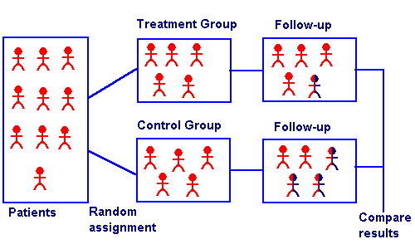
PART 2 EXTERNAL VALIDATION (OR EFFECTIVENESS)
External validation is best achieved by means of a Randomized Controlled Trial:

Slide 12
Experimental and control group
Control Group
Experimental Group
the experimental group (or experimental condition) refers to the group of participants who are exposed to the technological intervention.
the control group (or control condition) refers to the group of participants who are not exposed to the technological intervention.

Slide 13
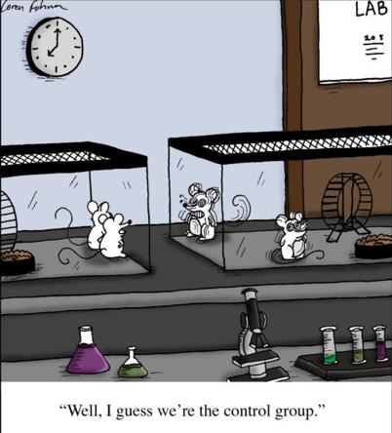
THE CONTROL GROUP
N.B.= During Clinical trials, not getting any treatment is often not an option for the participants.
Why do you think this is the case?
How could you solve this issue?

Slide 14
Evaluating intervention effects
If this was the outcome of your external validation process, how could you tell if the difference is significant?
Performance measurements based on number of weekly cigarettes
Before After
measurement measurement

Slide 15
Is the difference significant or due to chance?
You need to establish this through a statistical analysis, for instance:
T-tests
repeated measures design
ANOVA (Analysis of Variance)
ANCOVA (Analysis of Covariance)
The primary output of statistical tests is the p-value (probability value). It indicates the probability of observing the difference if no difference exists.
These tests are widely used in a.o. Social Sciences & Economics
The easiest type of statistical test is a t-test comparing the performances of two groups of users (one measurement each).
Notes:
Not

Slide 16

Subjective or objective measurement?
NB:= You can track the number of cigarettes smoked by participants through self-report, subjective measurements (e.g. questionnaires), BUT at the same time you should use more objective ways to track these data as well.
A sensor that keeps track of every time a cigarette package is opened? Or a sensor that detects cigarette smoke in the proxiomity of the participant’s faces?
Measuring people’s behavior can be complicated. If possible, multiple sensors should be used, along with self-report measurements.
How can we measure smoking behavior in an objective way?

Slide 17
PART 3 Research protocol
You need to become familiar with the following terms, which you will use to write up your Research Protocol:
Research Question (is the objective of a study or a problem to be solved through research)
Hypothesis (is a proposed explanation for a phenomenon)
Experimental and Control group (respectively, the group of participants who are exposed to the technological intervention and the group of participants who are not exposed to the technological intervention)
Independent Variable (the variable that is changed or controlled in a scientific experiment to test the effects on the dependent variable.)
Dependent variable (the variable being tested and measured in a scientific experiment.)
Subjects/participants (the people taking part in the experiment/intervention)
Possible Confounding variables (extra independent variables that are having a hidden effect on your dependent variables)

Slide 18
Example : (schematic) research protocol
Research Question: Is it possible to reduce smoking behavior by using a smart app that gives tailored advice to its users?
Hypothesis: A smart app reduces smoking behavior more than an app that gives only information to its users, and little to no tailored advice.
Control Condition and Experimental Condition: Half of the test subjects are given an app that provides only information to its users, and little to no tailored advice, while the remaining half is given a smart app that gives tailored advice to its users.
Independent Variable: Intervention (with or without the smart app)
Dependent variable: smoking behavior (e.g. number of weekly cigarettes)
Test Subjects: E.g. Male, Dutch High educated, have been smoking for more than 10 years.
Possible Confounding Variables: E.g. the interface is not user-friendly, and therefore the participants stop using the app.
Notes:
Bv controle groep: gebruikt
beschrijf wat je resultaten eventueel zou kunnen vertroebelen en hoe je daarvoor kunt controleren!!
een app maar de app geeft geen voorlichting? Experimenteel: geeft op de manier zus en zo advies. (maak plaatje)

Slide 19
How can you test a research question?
‘Example: Does the use of a running app lead to more exercise?’
Here are some examples:
By letting 100 test subjects use the running app and then asking them whether it worked ot not.
By letting 100 test subjects use the running app and tracking their physical activity through a sensor while they are using the app.
By letting 100 test subjects use the running app, and at the same time letting 100 tests subjects use a puzzle app. Then, the physical activity of both groups can be tracked, and if there is a difference, it can be investigated whether it is statistically significant or not.
By letting 100 test subjects use the running app, and at the same time sending 100 tests subjects information materials through the mail. Then, the physical activity of both groups can be tracked, and if there is a difference, it can be investigated whether it is statistically significant or not.

Slide 20
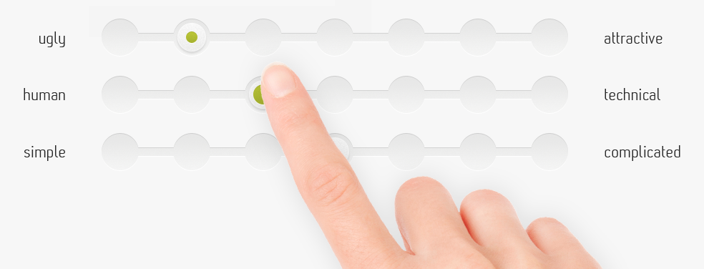
User experience evaluation
Your Research protocol needs to be externally validated through User Experience Evaluation.
User Experience (Usability): Do you think it works? Is it easy to use? Will you keep using it? Do you like it? Is it cost-effective and feasible?
Questionnaires (often based on a likert-scale) are used to evaluate user experience . Examples include:
Acceptability questionnaire
Usability questionnaire
Feasibility questionnaire

Slide 21
Acceptability, usability and feasibility
Acceptability: Acceptability refers to the factors that affect the users’ willingness to use the application.
Usability: Usability refers to the design factors that affect the user experience of operating the application’s device and navigating the application for its intended purpose.
Feasibility: Feasibility refers to whether the intervention can actually be carried out or not.

Slide 22
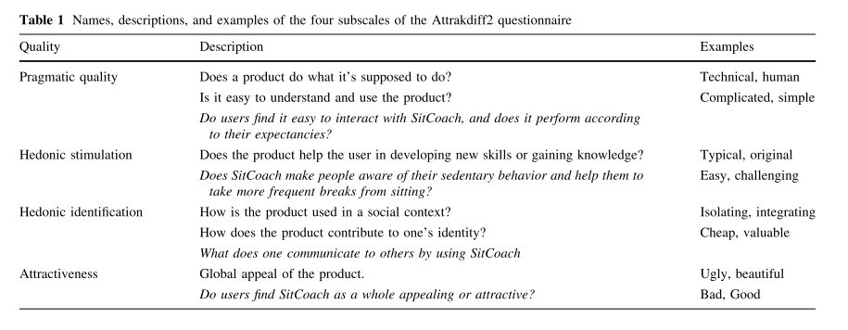
Example of usability questionnaire for ‘sitcoach’ system
Notes:
The Attrakdiff 2 questionnaire [19] is a usability questionnaire, assessing various qualities of SitCoach.
The questionnaire contains 28 items, consisting of a seven-point rating scale with two bipolar anchors to mark the opposing ends of the scale (e.g., confusing—clear, ugly—beautiful).
The questionnaire consists of four 7-item subscales, each measuring a different quality of the evaluated product (see Table 1).
The combination of the four qualities determines whether the concept is practical, meaningful, and pleasant to use.
High scores on all qualities are important for a prolonged usage of a product.
‘ hedionic’ ‘plezierig’ /’ gevoelsmatig’
SitCoach
Prolonged sitting time is a potential health risk, not only for people with an inactive lifestyle, but also for those who do meet the recommended amount of physical activity. In this paper, we evaluate SitCoach, a mobile application to nudge people from their seats. SitCoach monitors physical activity and sedentary behavior to provide timely feedback by means of suggesting sitting breaks. A pilot experiment with a group of 8 users learned that the general awareness of the importance of sitting breaks is low. Combined with the belief that the ability to take sitting breaks is highly dependent on externalfactors, a strategy of proposing break reminders may not be the most successful for this target group. Future work should focus on creating awareness of the problem and providing insights into personal sitting behavior.

Slide 23
Exercise 2: set up research protocol
Exercise: get back to the technological intervention you had thought of for the first exercise. Use the categories below to write up a schematic research protocol to test the (external) validity of your technological intervention:
Research questions
Hypothesis
Conditions: Control & Experimental
Independent variable
Dependent variable
Test subjects
Possible confounding variables
Do not forget to provide information about the questionnaire that will be used to evaluate your system (acceptibility/feasibility/cost-effectiveness, etc.).Which categories are you going to investigate? What do these questions lists measure? Provide examples.
After 10 minutes, I will pick a couple of groups and ask them to present their research protocol to the class.
Notes:
2

Slide 24


